Slide 1
Title
Backgrounder on Random Forests
(for R Workshop Scenario 4; view notes pages for accompanying narrative)
F. Chris Jones and P. Schaefer
Notes:
The R workshop is focused on “how to do stuff in R”, not on “how to do stats”, so a lot of theoretical discussion is omitted or glossed over.
This presentation provides some background information on random forests that workshop participants might find helpful if they want to adapt the script associated with Scenario 4 for their own purposes.

Slide 2
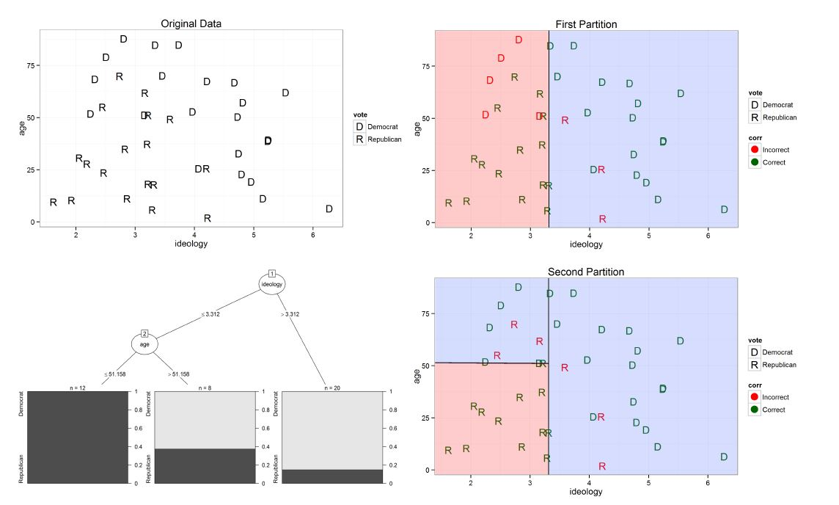
Study Design: CART
Photo credit: Jones and Linder 2015
Notes:
In the 15 or so years since they were first described (i.e., By Breiman 2001) random forests have received a lot of attention from scientists seeking to create “predictive” or “descriptive” models (sensu Shmueli 2010).
Random forests are an extension of classification and regression trees (CART), which we will explain first.... CART is a recursive partitioning algorithm. It works by splitting Y observations into ever more homogeneous groups: It first makes a list of every unique value of each predictor. It uses each of these predictor/predictor-value combinations to split the observations of Y into two groups: a group of Ys having values of the predictor that are lower or equal to the chosen value, and a group of Ys having values of the predictor that are higher than the chosen value. The homogeneity of the resulting groups is assessed, and the predictor and value combination that gives the most homogeneous groups is used as the first node in the model. This process is iterated to further divide sub-groups until a stopping criterion is satisfied.
To illustrate....At top left is a plot of raw data. This is a classification example. The response variable is a categorical factor (Political Affiliation, with 2 levels: Democrat or Republican). We have only 2 predictors, one numeric: (age) and one ordinal (ideology ... a measure of satisfaction with Trump’s hair style). The algorithm’s first two splits are shown in the coloured panes on the right. The first optimal split was on ideology, at a value of around 3.3, which formed a group of mostly democrats on the right and mostly republicans on the left. The second optimal split was on age, so the final model had three resulting groups, a nearly homogeneous group of democrats on the right-hand side, a homogeneous group of republicans at lower left, and a heterogeneous group of democrats and republicans in the upper-left group.
This information is summarized as a “tree” diagram, like the one in the lower left pane. CART trees are often shown as growing upside down, with the root node (first split) at the top, and branches extending downward. The nodes in the tree (ellipses) represent a predictor and specific predictor value where a locally optimal split is made. The lines (or branches) describe the two decision outcomes that are possible at each split. The terminal nodes (or leaves, shown as the row of rectangles at the bottom) constitute the final groups. In a classification context, such as this one, each terminal node is characterized by its counts of members in each factor level of Y, or by “majority vote” (i.e., by its most represented factor level). In a regression context, terminal nodes are described by their distributions of Y values, or by some other statistic, usually their means.

Slide 3
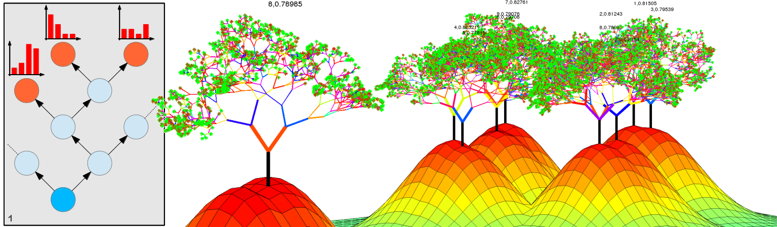
Random Forests
Photo credit: http://www.rhaensch.de/images/projects/vrf_teaser.png
Notes:
One of the issues with CART is that it suffers from “overfitting”…. Theoretically, a tree can be grown until terminal nodes are perfectly homogeneous. Such a tree would perfectly summarize its input dataset but would perform poorly on new data because various sources of error in the dataset would be incorporated into the tree, so it wouldn’t generalize well. Stopping criteria attempt to find a balance between growing a big tree that overfits the data and growing a little shrub that glosses over important details.
Random forests extend the CART method by creating a large forest of classification or regression trees, each one built from a large random subset of the observations, and for each split, considering a large random subset of the predictors. The random forest’s overall predicted Y value for any given combination of X is reported as the mean from all of the trees. In other words, to get a predicted value, a data point, consisting of a vector of given predictor values is “dropped down” each of the trees in the forest and lands in one of each tree’s terminal nodes. The overall prediction (in a regression context) is the mean value from all trees, and (in a classification context) is the most represented factor level.
Growing the forest is done primarily to reduce overfitting and increase the model’s generality. The model’s parameters (i.e., arguments in the R code) can be adjusted to tune the model. The default is to grow 500 trees for each forest, each tree being based on a random selection of n rows (n being equal to the number of observations), and at each node, considering a random 1/3 of the predictors as candidate splitting variables.

Slide 4
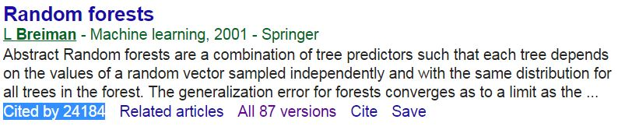
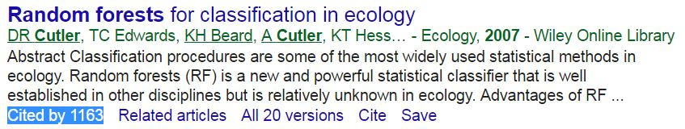
Random Forest rationale
Notes:
Random forests are well known to science, as you can see from the blue-highlighted citation counts, and they have some characteristics that ecologists see as promising...
CART and Random Forest models make no assumptions about the distributions of predictor or response variables
Unlike in multiple regression, it is not necessary to maintain a certain ratio of predictors, relative to observations. In fact, the input dataset can contain many more predictors than observations
The model can handle multicollinearity and complex interactions among predictors (without these interactions having to be pre-specified), which makes the technique useful for modeling cumulative effects
Random forests model cumulative effects in a way that handles complex interactions among predictors and non-linear relationships between predictors and the response variable
The random selections of observations and predictors that are made as each tree is added to the forest result in a form of cross-validation being incorporated into the model, which improves confidence in the model’s generality, relative to conventional regression
The random forest provides insights about the relative importance of the predictors, and allows “partial dependence plots” to be generated for each predictor in each model. Partial dependence plots model individual effects of different predictors and are akin to dose-response curves, because they model the expected value of Y across the observed range of a specified X, given the average effects of all other predictors in the model.

Slide 5
References and Further Reading
Notes:
Breiman, L. (2001). Random forests. Machine learning, 45(1), 5-32.
Cutler, D. R., Edwards, T. C., Beard, K. H., Cutler, A., Hess, K. T., Gibson, J., & Lawler, J. J. (2007). Random forests for classification in ecology. Ecology, 88(11), 2783-2792.
Izenman, A. J. (2013). Recursive Partitioning and Tree-Based Methods. In Modern Multivariate Statistical Techniques (pp. 281-314). Springer New York.
Jones, Z., & Linder, F. (2015, April). Exploratory data analysis using random forests. In Prepared for the 73rd annual MPSA conference.
Liaw, A., & Wiener, M. (2002). Classification and regression by randomForest. R news, 2(3), 18-22.
Shmueli, G. (2010). To explain or to predict?. Statistical science, 289-310.
Strobl, C., Boulesteix, A. L., Kneib, T., Augustin, T., & Zeileis, A. (2008). Conditional variable importance for random forests. BMC bioinformatics, 9(1), 1.

